Slide 1

Operating Systems
Lecture 41
Syed Mansoor Sarwar

Slide 2
Agenda for Today
Review of the previous lecture
Thrashing
The Working Set Model
Page Fault Frequency Model
Other Considerations
  Prepaging
  Page size
  Program structure
Examples

Slide 3
Review of Lecture 40
Belady’s Anomaly
Page Replacement Algorithms
  Least Frequently Used (LFU)
  Most Frequently Used (MFU)
  Page Buffering Algorithm
Allocation of Frames
Minimum Number of Frames
Thrashing

Slide 4
Allocation of Frames
Each process needs a minimum number of frames so that its execution may be guaranteed on a given machine .
Example: MOV X,Y
  Instruction is 6 bytes long (16-bit offsets) and might span 2 pages.
  2 pages to handle from.
  2 pages to handle to.

Slide 5
Allocation of Frames
0
1
2
3
4
5
6
7
8
9
Instruction
X
Y

Slide 6
Thrashing
If a process does not have “enough” pages, the page-fault rate is very high. This leads to:
  Low CPU utilization
  Operating system thinks that it needs to increase the degree of multiprogramming.
  Another process added to the system—serious problem!

Slide 7
Thrashing
A process is thrashing if it is spending more time paging (i.e., swapping pages in and out) than executing
Thrashing results in severe performance problems
  Low CPU utilization
  High disk utilization
  Low utilization of other I/O devices

Slide 8

Thrashing

Slide 9
Thrashing
To stop thrashing, the degree of multiprogramming needs to be reduced
Local page replacement prevents thrashing to spread among several processes
However, a thrashing process consumes more resources

Slide 10
Locality of Reference
Why does paging work?
Locality of Reference Model
  The set of pages a process accesses actively, is known as its locality
  Process migrates from one locality to another
  Localities may overlap

Slide 11
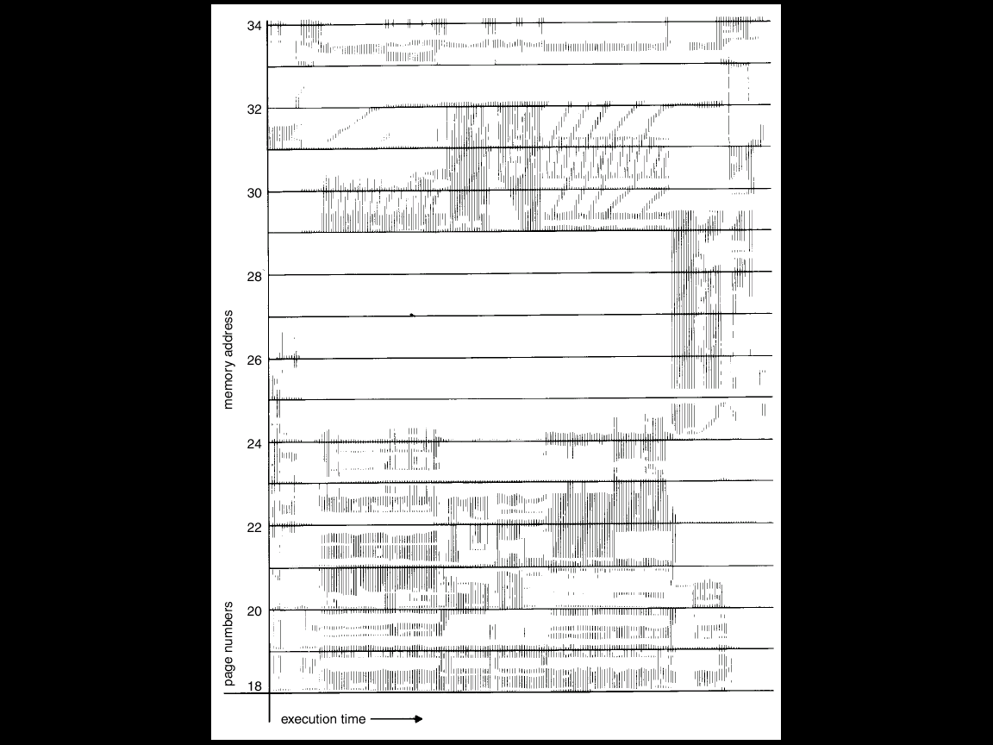
Process Localities

Slide 12
Working Set Model
Working Set Window (Δ)
A fixed number of page references, e.g., 10,000 references
Working Set Size of Pi (WSS_{i})
Total number of pages referenced in the most recent Δ

Slide 13

Working Set Model
Let Δ = 10 references

Slide 14
Process Localities
Δ
Δ
Δ
Δ
Δ
Δ
Δ
Δ
The first two and last localities are:
L1 = {18-26, 31-34}
L2 = {18-23, 29-31, 34}
Last = { 18-20, 24-34}

Slide 15
Working Set Model
If Δ is too small, it will not encompass an entire locality
If Δ is too large it will encompass several localities
If Δ = ∞ ⇒ will encompass entire program

Slide 16
Working Set Model
If D is the total demand of frames in the system, then
D = Σ WSS_{i}
If m is the total number of frames in the system, then
D > m ⇒ Thrashing
Policy: if D > m, then suspend one of the processes

Slide 17
Keeping Track of the Working Set
Approximate with a fixed interval timer and a reference bit
Example: Δ = 10,000 references
  Timer interrupts every 5000 references
  Keep in memory 2 bits for each page
  Whenever a timer interrupts, copy all reference bits and set their values to 0
  After Δ references, if one of the bits in memory = 1 ⇒ page in the working set

Slide 18
Keeping Track of the Working Set
Why is this not completely accurate?
Improvement: Use 10 reference bits and interrupt every 1000 references

Slide 19
Page-Fault Frequency
Another method to control thrashing.
OS keeps track of the upper and lower bounds on the page-fault rates of processes
If page-fault rate falls below the lower limit, the processes loses frames. If page-fault rate goes above the upper limit, process gains frames.

Slide 20

Page-Fault Frequency Scheme

Slide 21
Other Considerations
Prepaging
Page size selection
  Internal fragmentation
  Page table size
  Locality
  I/O overhead
    Reduced with small page size because locality improves

Slide 22
Other Considerations
Program structure
  int A[1024][1024];
  Matrix is stored in row-major order
  Each row is stored in one page
  Program 1 for (j = 0; j < 1024; j++)
  for (i = 0; i < 1024; i++)
  A[i,j] = 0;
  1024 x 1024 page faults

Slide 23
Other Considerations
Program structure
  int A[1024][1024];
  Matrix is stored in row-major order
  Each row is stored in one page
  Program 2 for (i = 0; i < 1024; i++)
  for (j = 0; j < 0124; j++)
  A[i,j] = 0;
  1024 page faults

Slide 24
Example System
A demand paging system with the following utilizations:
  CPU = 20%
  Paging disk = 97.7%
  Other I/O devices = 5%
Which of the following will improve CPU utilization?
  Install a faster CPU
  Increase degree of multiprogramming
  Decrease degree of multiprogramming
  Install more main memory

Slide 25
Example
Which of the following programming techniques and structures are “good” for a demand paged environment? Which are bad? Explain your answer.
  Stack
  Hash table
  Sequential search
  Binary search
  Indirection
  Vector operations

Slide 26
Recap of Lecture
Thrashing
The Working Set Model
Page Fault Frequency Model
Other Considerations
  Prepaging
  Page size
  Program structure
Examples

Slide 27
Operating Systems
Lecture 41
Syed Mansoor Sarwar

